Slide 1

An Introduction to

Slide 2
What is MongoDB ?
-> MongoDB is a document database with the scalability and flexibility that you want with the querying and indexing that you need.
-> NoSQL Database

Slide 3
Why MongoDB ?
Fully elastic database as a service with built-in best practices
End-to-end security
Management tooling for automation, monitoring, and backup
can store data of any structure and modify your schema at any time as you add new features to your applications
Non-relational database

Slide 4
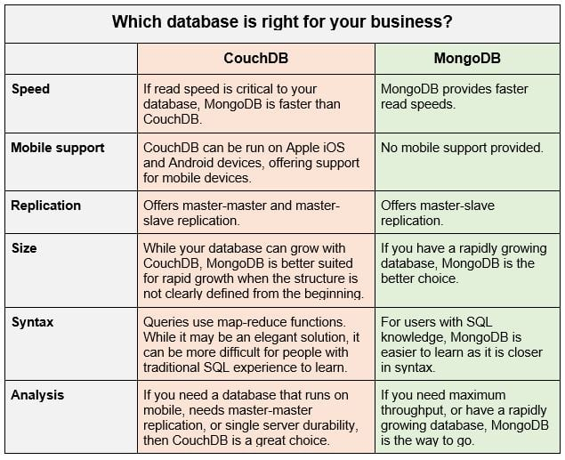
Couch VS Mongo
Couch Vs Mongo

Slide 5
Drivers
JavaScript
Python
Ruby
PHP
Perl
Java
Scala
C#
C
C++
Haskell
Erlang
Plus numerous 3rd party tools and libraries!

Slide 6
A BSON (binary JSON) document
{
"_id" : ObjectId("52832eb59f36fe144eeea8dc"),
"baseprice" : 8.99,
"category" : "toys",
"colors" : [ "red", "green", "cosmic purple"],
"name" : "Cosmic Yo-yo",
"promotions" : [
{ "coupon" : "XY678", "saleprice" : 7.99, "expires" : ISODate("2013-12-12T00:00:00Z") },
{ "coupon" : "AB8888", "saleprice" : 7.49, "expires" : ISODate("2014-01-01T00:00:00Z") }
]
}

Slide 7
Terminology
Database -> Database
Table -> Collection
Record / Row -> Document
Field -> Field

Slide 8
Ids
ObjectId is a 12-byte BSON type, constructed using:
a 4-byte value representing the seconds since the Unix epoch,
a 3-byte machine identifier,
a 2-byte process id, and
a 3-byte counter, starting with a random value
Show with .getTimestamp()

Slide 9
find()
db.products.findOne()
db.products.find()
db.products.find()
db.products.find({ _id : ObjectId("52832eb59f36fe144eeea8dc") })

Slide 10
Queries
db.products.find().sort( { baseprice : -1 }).pretty()
db.products.find().limit(1).pretty()
db.products.find().limit(1).skip(1).pretty()

Slide 11
Conditions
db.products.find({ baseprice : { $gt : 4.99 }})
db.products.find({ baseprice : { $lte : 4.99 }})
db.products.find({ promotions : { $lte : 4.99 }})
db.products.find( { colors : { $in : ["red"] }})
db.products.find( { "promotions.coupon" : { $in : [ "XY678" ] }}).pretty()
db.products.find({ $and : [{ category : "toys"},{ baseprice : { $gt : 4.99 }}]}

Slide 12
Other Queries
db.products.count()
db.products.find({ baseprice : { $gt : 2.99 }}).count()
db.products.insert({ name : "Juggle-O-rama", baseprice : 11.99 })
db.products.update({ name : "Juggle-O-rama" }, { $set : { category : "toys" }})
db.products.update({ name: “Juggle-O-rama” }, { $set : { colors : ["silver", "gold"]}})
db.products.update({ name: "Juggle-O-rama" }, { $push : { colors : "sea foam green"}})
Don’t forget $set!

Slide 13
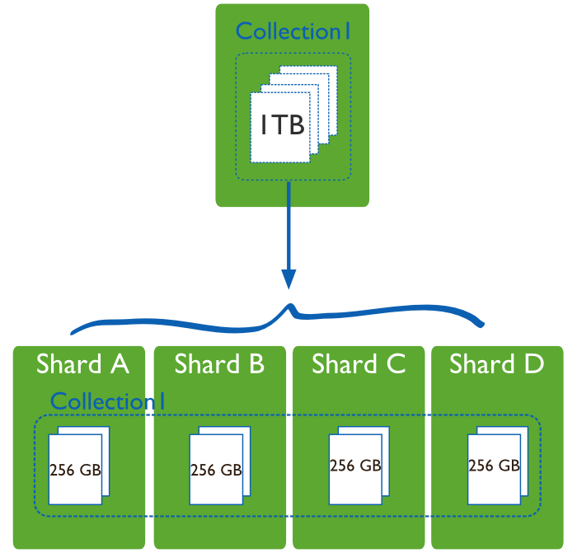
Sharding
Collections are split amongst multiple servers by a shard key
Used to scale writes

